Slide 1

ICT Academy of Kerala
Building the Nation’s Future
JavaScript

Slide 2

UNIT 1
Introduction
to
JavaScript

Slide 3
How JavaScript Works
JavaScript is a Dynamic programming language for web browsers.
Interpreted programming language with object oriented concepts.
Client side scripting language, that runs inside a browser
Improve the user experience of a website.
Notes:
JavaScript
JavaScript is a interpreted, light weight, dynamic Programming Language used as a part of web pages. JavaScript helps to write code for interacting the user with the web pages. JavaScript makes the webpages more dynamic.
JavaScript has object oriented capabilities so that real time concepts can be easily covert in to the form for scripts.
Client side scripting language:
JavaScript is most commonly used for client side scripting, that runs inside an internet browser.
All the client side data validation scripts can be coded using JavaScript rather than using CGI server side scripts.
Advantages:
Reduces server interactions and speedup the web page response to the user
Can provide richer user interfaces by making the web pages more dynamic.

Slide 4
JavaScript Console
JavaScript console is also known as DevTools.
Used for debugging the JavaScript
Both Chrome and Firefox have excellent JavaScript console.
We can find the Developer Tools in chrome and Web console in Firefox for debugging.
Notes:
JavaScript console
JavaScript console is also known as DevTools used for debugging the JavaScript code.
Both Chrome and Firefox have excellent JavaScript console.
We can find the Developer Tools in chrome and Web console in Firefox for debugging.
Let's print to this console using the console.log method.
console.log('Hello world!');

Slide 5
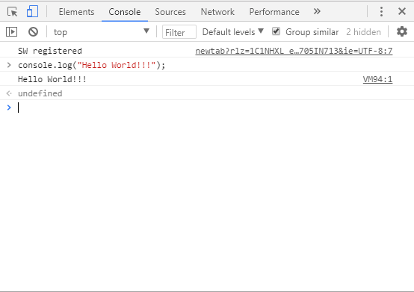
JavaScript Console

Slide 6
JavaScript Syntax
JavaScript code can be written as follows.
<script…>
JavaScript Statements
</script>
<script> tag can be placed anywhere in the webpage. But normally recommended to place inside <head> tag.
Notes:
JavaScript Syntax
JavaScript can be coded within the <script>... </script>.
<script> tag can be placed anywhere in the webpage. But normally recommended to place inside <head> tag.
The <script> tag alerts the browser program to start interpreting all the text between these tags as a script.
JavaScript code can be written as follows.
<script…>
JavaScript Statements
</script>

Slide 7
Script tag attributes
<script language=“javascript” type=“text/javascript”>
JavaScript Statements
</script>
Language:- type of scripting language you are using. Its value will be javascript.
Type:- Its value should be set as text/javascript.
Notes:
Script tag attributes:
<script language=“javascript” type=“text/javascript”>
JavaScript Statements
</script>
Language:- type of scripting language you are using. Its value will be javascript.
Type:- Its value should be set as text/javascript.

Slide 8
Placing JavaScript code in HTML
JavaScript code can be placed,
Inside <head> section.
Inside <body> section.
As an external file.
JavaScript code can be written in an external file and it can be imported to an html file as follows.
JavaScript file extension is “.js”
<script type="text/javascript" src="filename.js" >
</script>
Notes:
Placing JavaScript code in HTML
JavaScript code can be placed,
Inside <head> section.
Inside <body> section.
As an external file.
JavaScript code can be written in an external file and it can be imported to an html file as follows.
<script type="text/javascript" src="filename.js" >
</script>

Slide 9
First Program
<html>
<body>
<script>
document.write("Hello World!");
</script>
</body>
</html>
document.write() - For writing something on the browser using javascript.
Notes:
First Program
<html>
<body>
<script>
document.write("Hello World!");
</script>
</body>
</html>
document.write() - For writing something on the browser using javascript.

Slide 10
Thank you

